Slide 1
My visualization By: Richard Kemonou

Slide 2
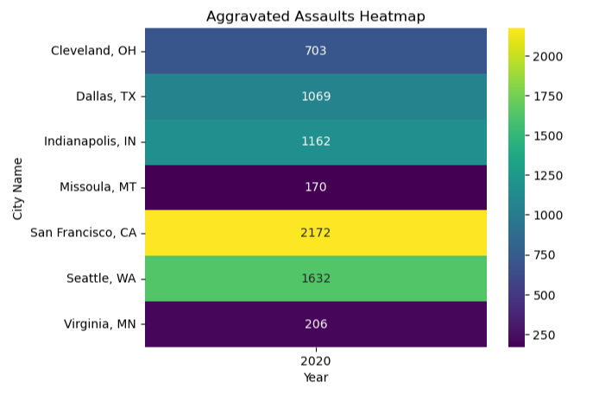
Heatmap using Seaborn for 2021 aggravated assaults

Slide 3
Description of the previous visualization
The heatmap displays the number of aggravated assaults in various cities during the year 2020.
The color intensity represents the frequency of assaults, with darker colors indicating higher numbers. San Francisco, CA, has the highest count with 2,172 aggravated assaults, as indicated by the yellow color.
Cities like Missoula, MT, and Virginia, MN, have significantly lower numbers of aggravated assaults, with counts of 170 and 206 respectively, reflected by the dark blue color.

Slide 4
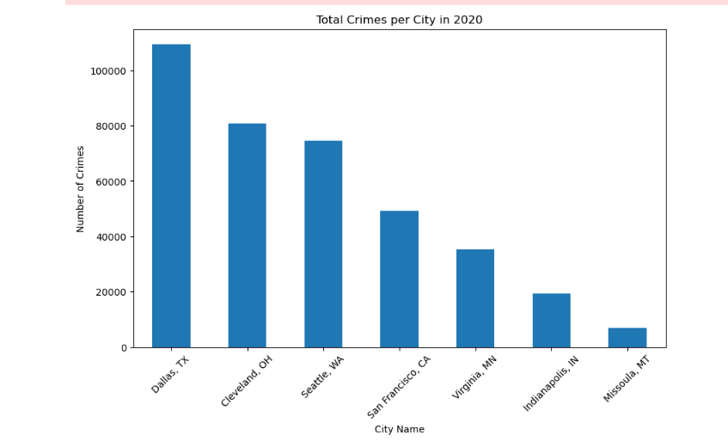
Bar Chart for Comparing the Total Crimes per City:

Slide 5
Description of the previous visualization
The chart is titled "Total Crimes per City in 2020" and displays the number of crimes for each city listed on the x-axis.
Dallas, TX, has the highest number of reported crimes, exceeding 100,000, followed by Cleveland, OH, and Seattle, WA, which also have high crime counts.
San Francisco, CA, Virginia, MN, Indianapolis, IN, and Missoula, MT, show progressively fewer crimes, with Missoula, MT, having the lowest number of reported crimes on the chart.

Slide 6
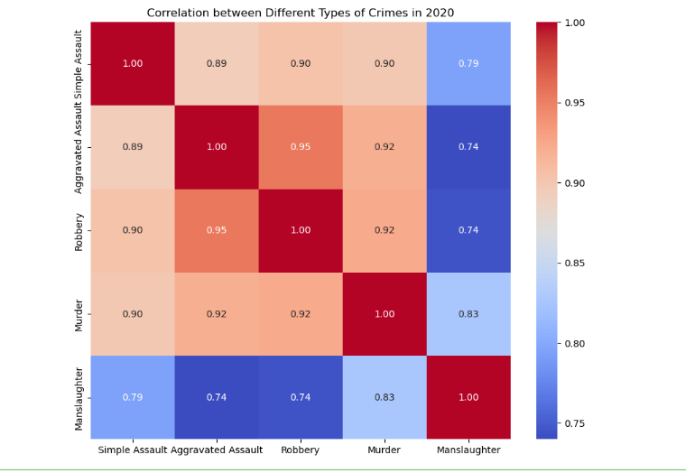
Heatmap for Crime Types Correlation:

Slide 7
Description of the previous visualization
The heatmap shows the correlation between different types of crimes in 2020, with values ranging from 0.74 to 1.00, where 1.00 indicates a perfect correlation.
High correlations are observed between aggravated assault, robbery, and murder, with values equal to or above 0.90, indicating that these crime rates tend to increase or decrease together.
The lowest correlation is between manslaughter and other crimes, with the correlation coefficients ranging from 0.74 to 0.83, suggesting a less strong relationship between manslaughter and the occurrence of other listed crimes.

